Slide 1
ETH Hackathon 2024 Qilimanjaro Challenge
Nicolas, Kai, Alessandro, Felix

Slide 2
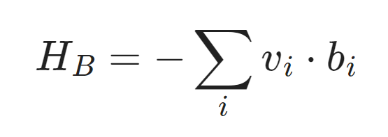
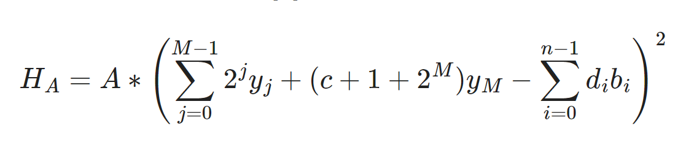

Problem 1
Implement cost hamiltonian
Add ancilla qubits [1]
Reference [1] claims this to be a perfect implementation H = H_A + H_B with
[1]: https://arxiv.org/abs/1701.05584

Slide 3
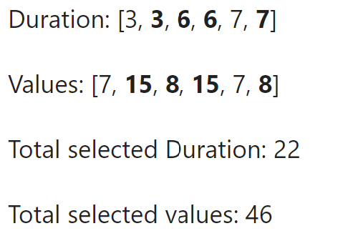
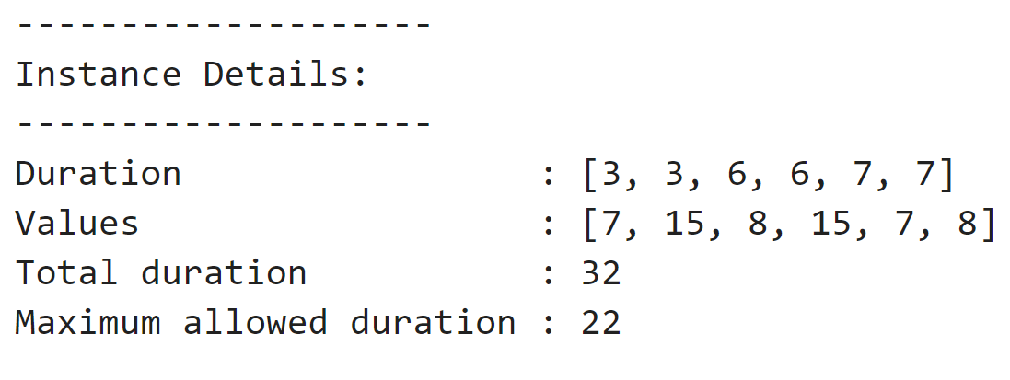
Results problem 1
Reference Knapsack problem

Slide 4
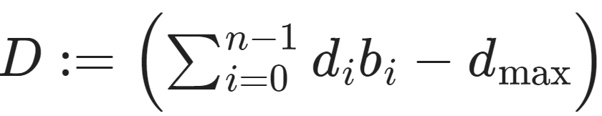

Problem 2 Now only 6 qubits
Solutions will not be exact :
Idea is to take an exponential cost function of the variable
If D>0 exponential increase of cost, if D <=0 reduced / minimal cost
However only have up to two qubit gate in implementation and a product of different b_i is a two qubit gate. Therefore only take the linear and quadratic term

Slide 5
Results problem 2
Compare heuristic solution with different parameters a & b with 500 exactly solved knapsack problems.
Try to optimize for these parameters such that the percentage of first correct eigenstate is the highest for a = 1 b = 4 :
1st position : 70 % 2nd position : 14.2 % 3rd position : 8.2 %

Slide 6
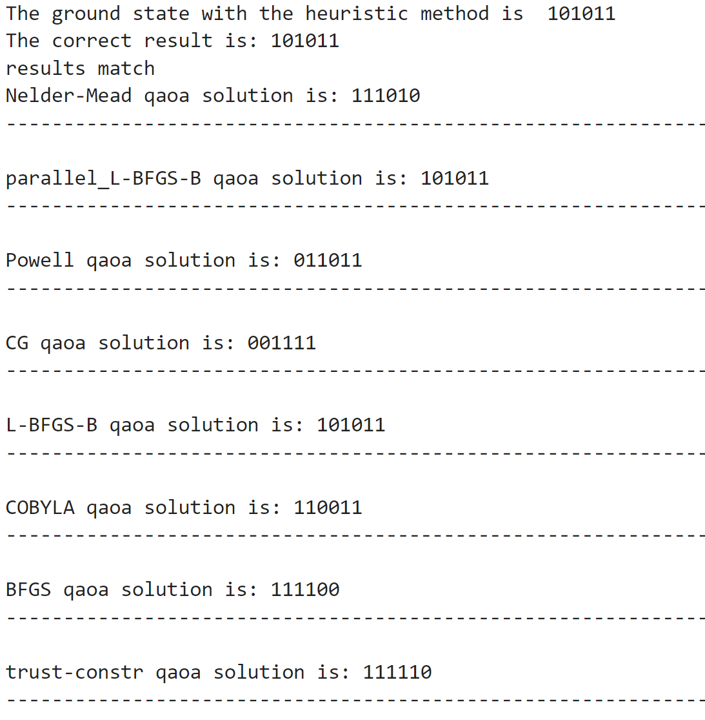
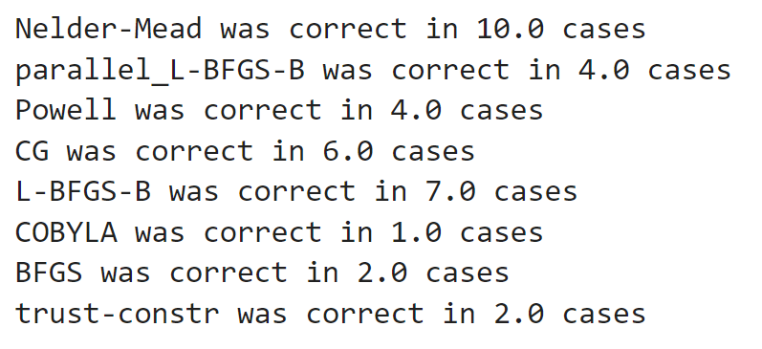
QAOA Problem

Slide 7
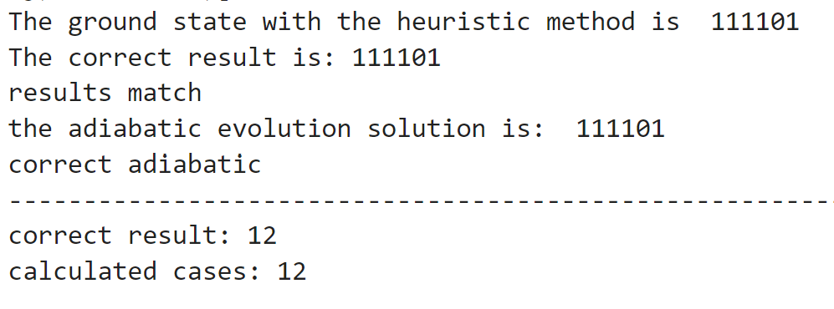
QAE problem

Slide 8
Problem 3
Starting Hamiltonian:
Final Hamiltonian:
D = sum(duration[i]*(1-Z(i))/2 for i in range(0,n)) - max_duration
H = -Σ(v_{j}(1 - Z)/2 for j in range(0,n)) + a*D*D + b*D
Circuit: 3 qubit + 3 couplers

Slide 9
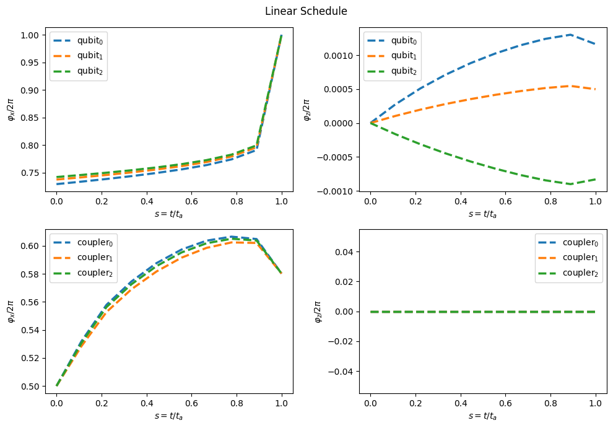

Slide 10
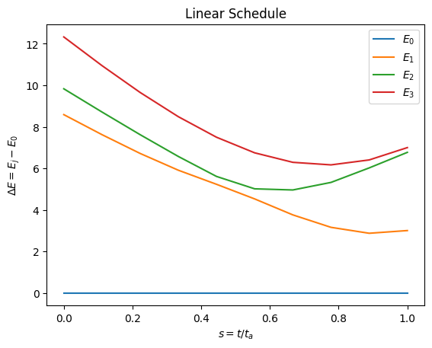

clear gap from ground state ΔE ~ 3
Minimum time step to respect variational theorem
ΔT ~ 1/(ΔE)² ~ 0.1

Slide 11
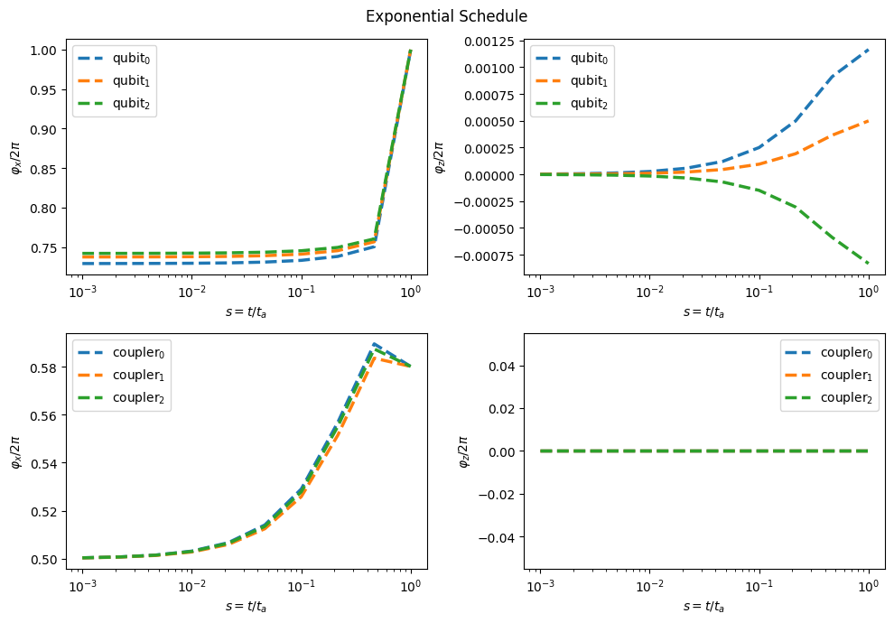
Exponential Schedule

Slide 12
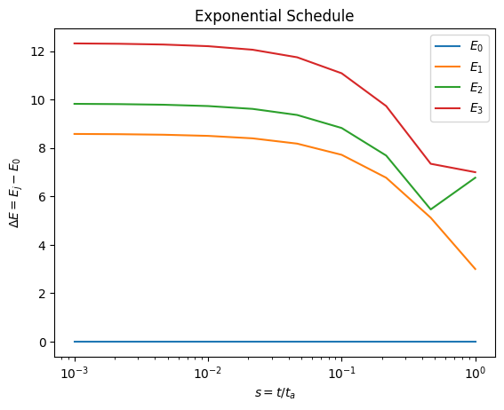
clear gap from ground state ΔE ~ 3
Variational criterion not respected anymore

